Slide 1
Identity Management
Sprint 2
Jacob Gianakopoulos, Steven Scott, Samuel Vitale, Alex Bowen, Andy Jolagh, Nick Attisha

Slide 2
Sprint 2 Plan
Our plan for this sprint was to regroup and plan using the feedback given to us during the last presentation, and also finish the basics for our own user registration and login system.
Jacob - Android app code, server code
Nick - Facial Recognition backend
Alex - UI design for , Powerpoint
Steven - Database design, password security
Samuel - Database design and implementation
Andy- UI design frontend

Slide 3
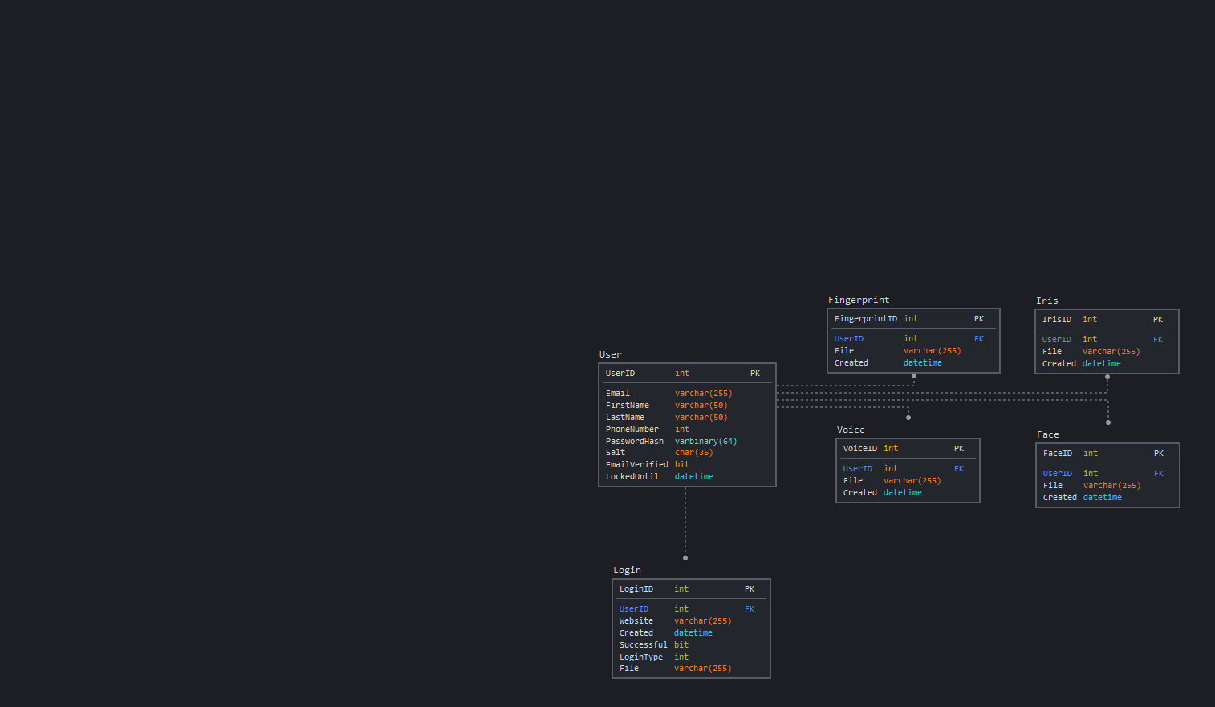
Database
Must still be hosted on the web server
For now, we are using local versions
Biometric files and password are
Stored outside the database
Password protection for security

Slide 4
Risks and Challenges
Distanced Communication and work
Short Sprint
Dealing with conflicting work schedules/ availability
Android Studio troubles
Integration issues
Unfamiliarity with software environment
We are working with sensitive information, and therefore must value security very highly when creating this product
Miscommunication

Slide 5
Backend Progress
Activities for login, registration, home screen, and user profile (still in progress)
A login task that allows users to login with there username and password
A registration task that allows users to create a new account with their email
An edit screen that allows people to update their profile (Still in progress)
Server code to accomplish these tasks

Slide 6
Backend To-Do
Finish profile edits and password resets
Add more meaningful error messages
Loading messages
Do more in-app checks before sending to server (blank fields, field length, valid emails, etc)
Add salt for password hashing
Future-proof code through refactoring
Add all code to a centralized server

Slide 7
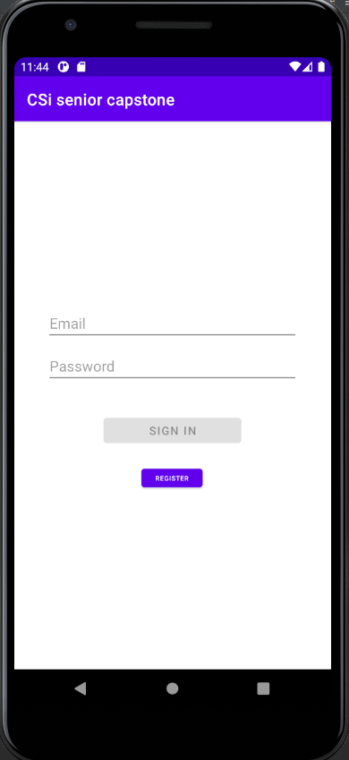
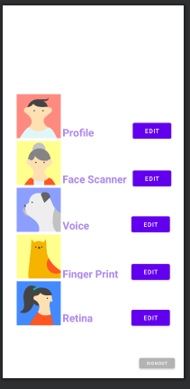
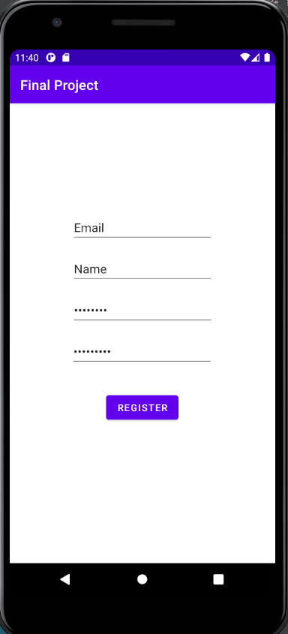
Conceptual UI Design (App)

Slide 8
Sprint Schedule
Project Details and Requirements
User Account Creation (Jan 21st - 25th)
Finish back end code for a safer login for users to store their information and finalize the main pages for the Application that will be used for the project. We would also like to start breaking down tasks for and working on Face recognition (Jan 26th - Feb 8th)
Focus on creating Face scanning feature in app. Improve design and functionality of the Application for android. (Feb 9th - 15th)
Potentially progressing towards working on the Fingerprint Scanner after figuring out the Face scanner(Feb 16th - March 1st)

Slide 9
Sprint 3 Preview: Finish Logins/ Face Recognition
Our approach for this sprint is to form groups of 2 and work together on the necessary tasks. We split the responsibilities as follows:
Database and Server - Steven and Samuel
Front-End design - Alex and Andy
Backend - Jacob and Nick

Slide 10
Sprint 3 User Stories and Tasks
Finish Base Login Functionality Includes salting passwords, requiring email verification, recording logins, and implementing better validation.
As a user, I want to be able to upload face data. Includes creating the front end for managing pictures, connecting to their camera to capture images, and saving it onto the server.
As a user, I want to be able to login via facial recognition
Includes Implementing the facial recognition package, updating the login page to show the new login option, and writing the backend code to log the user in when the face matches what is stored.

Slide 11
Demo

